Slide 1
What next 10th …??
-team vidhyadhaan

Slide 2
Short term courses
-team vidhyadhaan

Slide 3
contents
Digital Marketing Course
Graphic Designing Course
Web Designing Course
Diploma in Data Entry
Diploma in poultry farming
Diploma in Social media marketing
Diploma in Hotel Management and Catering Technology
Certification Course in Beauty and Wellness
Certificate Course in Photography
Certification Course in Event Management
Certification Course in Fashion Designing

Slide 4

1.Digital marketing
It is a rapidly growing field that has become an essential component of modern business
There are numerous courses, certifications, and institutions offering training in digital marketing.
Exam Required:
Google Ads Certification
Google Analytics Certification
Hubspot Inbound Marketing Certification
Facebook Blueprint Certification
Hootsuite Social Media Certification

Slide 5

1.Digital marketing
Institutions :
Simplilearn
Udacity
Digital Marketing Institute
Coursera
Hubspot Academy
Jobs Offered in the Market:
SEO Specialist
PPC Specialist
Social Media Manager
Content Marketing Manager
Email Marketing Manager
Types of Positions in Job:
Digital Marketing Executive
Digital Marketing Specialist
Digital Marketing Analyst
Digital Marketing Manager
Digital Marketing Director
Salary:
4,428,093.28 INR

Slide 6

2 .Web Designing Course:
Web designing courses are designed to teach students how to create and maintain websites.
The curriculum includes a combination of programming languages, design software, and web development tools.
Some common topics covered in web designing courses are HTML, CSS, JavaScript, jQuery, Photoshop, UX/UI design, and content management systems like WordPress.
Exam Required:
Adobe Certified Expert (ACE),
Google Analytics Individual Qualification (IQ),
Microsoft Technology Associate (MTA).

Slide 7

2 .Web Designing Course:
Institutions:
Udemy
Coursera
Skillshare
Lynda.com
Codecademy
Jobs offered:
Freelance Web Designer
In-house Web Designer
Agency Web Designer
UI/UX Designer
Front-end Developer
Full-stack Developer
Graphic Designer
Salary:
3,028,093.28 INR

Slide 8

3.Data entry course:
A data entry professional is responsible for inputting and updating information into a computer system or database.
The work involves typing, copying, and pasting data from various sources, ensuring accuracy and completeness of the information entered.
Exam Required:
There is no specific exam required
some institutions may conduct aptitude tests or assessments to evaluate the candidate's typing speed, accuracy, and computer skills.

Slide 9

3.Data entry course:
Jobs Offered :
Data Entry Clerk
Data Entry Operator
Database Administrator
Data Analyst
Institutions:
National Institute of Electronics and Information Technology (NIELIT)
Indira Gandhi National Open University (IGNOU)
Symbiosis Center for Distance Learning
Punjab Technical University
Types of Positions in Job:
Online Data Entry:.
Offline Data Entry:
Image to Text Conversion: Data Processing:
Salary:
INR 6-7 lakhs per annum.

Slide 10

3.Data entry course:
Jobs Offered :
Data Entry Clerk
Data Entry Operator
Database Administrator
Data Analyst
Institutions:
National Institute of Electronics and Information Technology (NIELIT)
Indira Gandhi National Open University (IGNOU)
Symbiosis Center for Distance Learning
Punjab Technical University
Types of Positions in Job:
Online Data Entry:.
Offline Data Entry:
Image to Text Conversion: Data Processing:
Salary:
INR 6-7 lakhs per annum.

Slide 11

4.Social media marketing:
A diploma in social media marketing prepares you to develop, execute and manage social media marketing campaigns.
A social media marketer's job is to create and publish content, run social media ad campaigns, analyze data, and manage social media accounts.
Exam Required:
There are no specific exams
some institutions may require you to take a basic aptitude test or provide a writing sample.

Slide 12

5. Graphic designing course:
A graphic designer's job is to create visual content for various mediums, such as websites, advertisements, magazines, books, packaging, and branding.
They work with a variety of digital tools, such as Adobe Creative Suite, Sketch, and Figma
Exam Required:
There are no specific exams
showcasing their work to demonstrate their skills and creativity..

Slide 13

5. Graphic designing course:
Jobs Offered :
graphic designer
web designer
UX designer
art director
creative director
marketing coordinator
Institutions:
National Institute of Design (NID):
Industrial Design Centre (IDC), IIT Bombay:
Srishti School of Art, Design and Technology:
DJ Academy of Design:
Pearl Academy:
MIT Institute of Design:
WLCI College India:
Salary:
INR 30 - 40lakhs per annum.

Slide 14
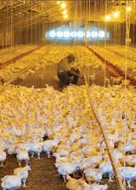
6. Diploma in poultry farming:
Managing the daily care and feeding of birds
Monitoring the health and welfare of birds
Cleaning and maintaining facilities,
Collecting and grading eggs,
Managing hatcheries
Marketing and selling poultry products

Slide 15

6. Diploma in poultry farming:
Exam Required:
Indian Council of Agricultural Research (ICAR) All India Entrance Examination for Admission (AIEEA) -
Maharashtra Council of Agricultural Education and Research (MCAER) Common Entrance Test (CET) -
Orissa University of Agriculture and Technology (OUAT) Common Entrance Exam (CEE) -
Acharya N.G. Ranga Agricultural University (ANGRAU) Polytechnic Admission Test (PAT) -

Slide 16
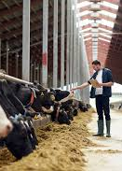
6. Diploma in poultry farming:
Institutions:
Several institutions offer Diploma in Poultry Farming. Some of the prominent ones are:
Tamil Nadu Veterinary and Animal Sciences University, Chennai
Kerala Veterinary and Animal Sciences University, Thrissur
Karnataka Veterinary, Animal and Fisheries Sciences University, Bidar
West Bengal University of Animal and Fishery Sciences, Kolkata
College of Veterinary and Animal Sciences, Mannuthy

Slide 17
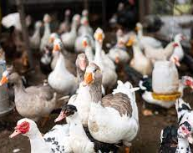
6. Diploma in poultry farming:
Jobs offered with Salary:
Poultry Farm Manager: $56,000 per year
Poultry Production Supervisor: $49,000 per year
Poultry Nutritionist: $63,000 per year
Poultry Veterinarian: $90,000 per year
Poultry Processing Plant Manager: $74,000 per year
Salary:
INR 30 - 40lakhs per annum.

Slide 18
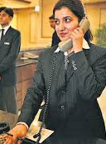
7.Diploma in hotel management & catering technology:
The hospitality industry such as hotel managers, food and beverage managers, catering managers, chefs, etc
It include managing hotel operations, organizing events, planning menus, supervising staff, maintaining inventory, and ensuring customer satisfaction.
Exam Required:
exams are NCHMCT JEE, IHM-Aurangabad Entrance Exam, AIHMCT WAT,

Slide 19
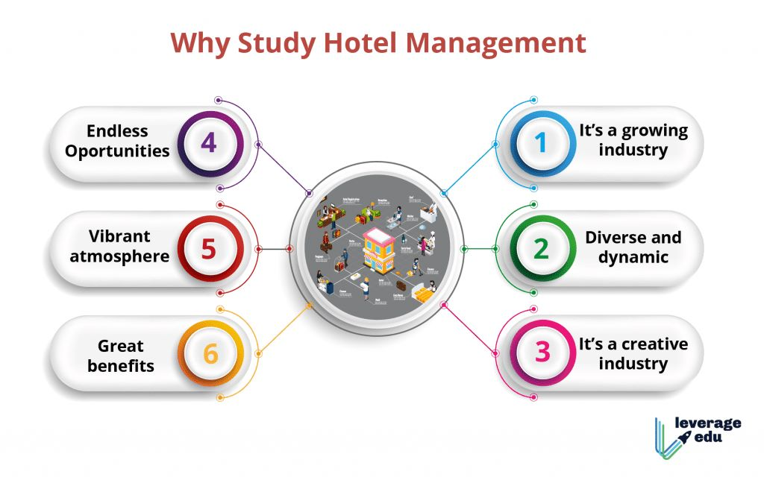




Slide 20
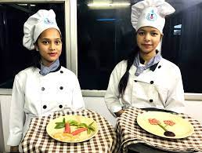
7.Diploma in hotel management & catering technology:
Institutions:
Institute of Hotel Management, Catering Technology and Applied Nutrition (IHMCTAN)
Oberoi Centre of Learning and Development (OCLD)
Welcomegroup Graduate School of Hotel Administration (WGSHA)
International Institute of Hotel Management (IIHM)
Salary:
INR 2 – 8 lakhs per annum.

Slide 21

7.Diploma in hotel management & catering technology:
Types of Positions in Job :
Hotel Manager: INR 3,00,000 to INR 10,00,000 per annum
Food and Beverage Manager: INR 2,00,000 to INR 8,00,000 per annum
Catering Manager: INR 2,50,000 to INR 7,00,000 per annum
Chef: INR 2,00,000 to INR 8,00,000 per annum
Event Manager: INR 3,00,000 to INR 8,00,000
Front Office Manager: INR 2,50,000 to INR 6,00,000

Slide 22

8.Fashion Designing:
Fashion designers create new styles, designs, and patterns for clothing, accessories, and footwear
They use their creative abilities to design clothing that is both functional and aesthetically pleasing
Exam Required:
There are no specific exams
candidates to clear an entrance exam or submit a portfolio of their work

Slide 23

8.Fashion Designing: :
Jobs Offered :
Fashion Designer
Fashion Illustrator
Fashion Stylist
Textile Designer
Fashion Merchandiser
Production Manager
Quality Control Manager
Fashion Coordinator
Institutions:
National Institute of Fashion Technology (NIFT)
Pearl Academy
JD Institute of Fashion Technology
Vogue Institute of Fashion Technology
INIFD
Salary:
INR 6-7 lakhs per annum.

Slide 24

9.Certification Course in Event Management:
Event management typically covers topics such as event planning, event marketing, vendor management, budgeting, risk management, and project management.
Exam Required:
There is no specific exam required
.

Slide 25


Slide 26

9.Certification Course in Event Management:
Institutions and Fee Structure:
Some institutions offering certification courses in event management in India are:
National Academy of Event Management and Development (NAEMD)
International Institute of Event Management (IIEM)
Event Management Development Institute (EMDI)
Indian Institute of Event Management (IIEM)
Generally ranges from INR 50,000 to INR 1,00,000.

Slide 27

9.Certification Course in Event Management:
Jobs Offered in Market and Salary:
Event Manager - INR 3-8 lakhs per annum
Event Coordinator - INR 2-5 lakhs per annum
Wedding Planner - INR 3-8 lakhs per annum
Event Marketing Manager - INR 4-10 lakhs
Exhibition Organizer - INR 3-8 lakhs
Event Operations Manager - INR 4-10 lakhs

Slide 28

10.Certificate Course in Photography:
Certificate Course in Photography is a short-term program that can help you to gain basic to advanced knowledge and skills in photography.
Exam Required:
There is no specific exam required for the Certificate Course in Photography.
However, some institutions may require you to submit a portfolio of your work to gain admission.

Slide 29

10.Certificate Course in Photography:
Institutions:
National Institute of Photography, Mumbai
Delhi School of Photography, Delhi
Light and Life Academy, Ooty
Raghu Rai Center for Photography, Gurgaon
Indian Institute of Photography, Noida
Fee Structure:
INR 20,000 to INR 1,50,000.

Slide 30

10.Certificate Course in Photography:
.
Types of Positions in the Job with Salary in INR:
Photographer - INR 1,50,000 to INR 5,00,000 per annum
Photo Editor - INR 2,00,000 to INR 6,00,000 per annum
Photojournalist - INR 2,50,000 to INR 8,00,000 per annum
Freelance Photographer - INR 2,00,000 to INR 10,00,000 per annum
Wedding Photographer - INR 1,50,000 to INR 5,00,000 per annum

Slide 31

11.Stock Market Training:
To work in the stock market, one needs to have a good understanding of the financial market and its various components, such as stocks, bonds, derivatives, mutual funds,
Exam Required:
There are no specific exams
To work in the stock market, one needs to clear various exams and certifications. Some of the popular exams include the NISM certification, the SEBI certification, and the CFA certification.

Slide 32

11.Stock Market Training:
Institutions:
NSE Academy, BSE Institute
National Institute of Securities Markets (NISM)
Indian Institute of Capital Markets (IICM),
Types of Positions and Salaries:
Financial Analyst: INR 3-8 lakhs per annum
Equity Research Analyst: INR 5-12 lakhs
Investment Banker: INR 10-30 lakhs per annum
Stockbroker: INR 3-10 lakhs per annum
Fund Manager: INR 8-20 lakhs per annum
Trader: INR 4-12 lakhs per annum

Slide 33

12.Certification Course in Beauty and Wellness:
The Certification Course in Beauty and Wellness is designed for individuals who want to gain knowledge and skills in various beauty and wellness techniques.
The course includes theory and practical sessions covering topics such as hair care, skin care, makeup, spa treatments, and more.
Exam Required:
There are no specific exams
To pass practical assessments or exams to demonstrate their knowledge and skills.
.

Slide 34
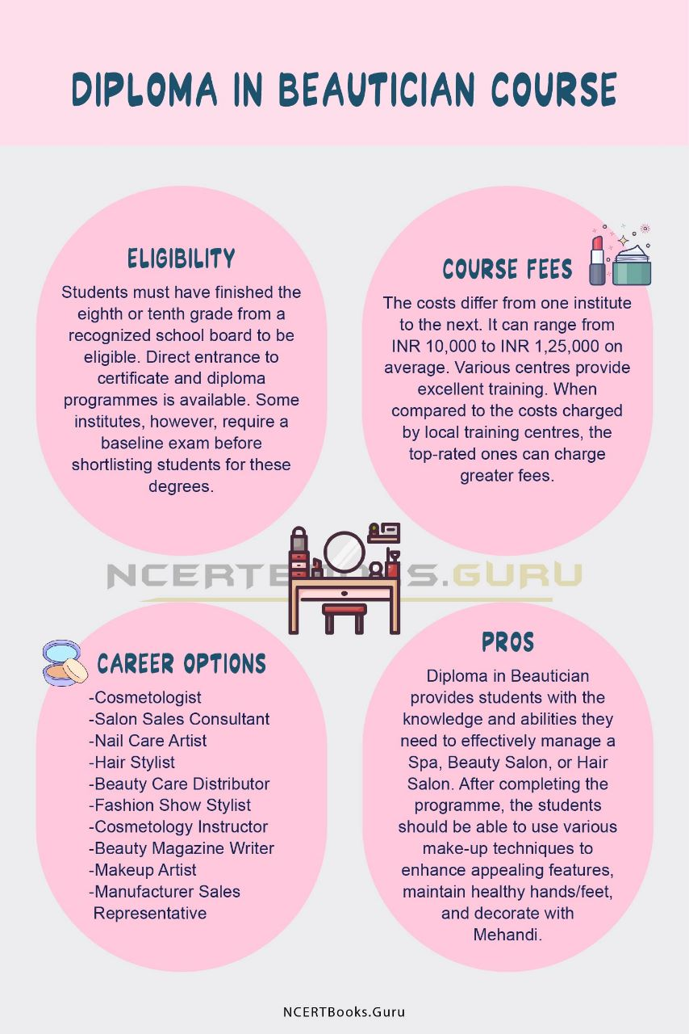





Slide 35

12.Certification Course in Beauty and Wellness:
Types of Positions in Job with Salary in INR:
Beauty Therapist: INR 1,50,000 to INR 3,50,000
Hair Stylist: INR 1,50,000 to INR 3,50,000
Makeup Artist: INR 1,50,000 to INR 5,00,000
Spa Therapist: INR 1,50,000 to INR 3,50,000
Wellness Consultant: INR 2,50,000 to INR 6,00,000
Beauty Trainer: INR 3,00,000 to INR 7,00,000
Salon Manager: INR 3,00,000 to INR 7,00,000

